Slide 1
Copyright © 2014 by Software Craftsmanship Guild.
All rights reserved. No part of these materials may be reproduced, distributed, or transmitted in any form or by any means, including photocopying, recording, or other electronic or mechanical methods, without the prior written permission of the Software Craftsmanship Guild. For permission requests, write to the Software Craftsmanship Guild, addressed “Attention: Permissions Coordinator,” at the address below.
Software Craftsmanship Guild
526 S. Main St, Suite 609
Akron, OH 44311

Slide 2
Intro To Databases
Software Craftsmanship Guild

Slide 3
Lesson Goals
Learn the basic terminology around relational databases

Slide 4
About SQL
SQL stands for “Structured Query Language” and it is the most used database language today. SQL is an ANSI standard, so while different vendors databases implement some special commands, the basic SQL commands work across all databases that are compliant.
SQL Server is the database environment and the SQL language is the tool set.

Slide 5
What is a Database?
A database is a collection of related information
It can be mundane things:
An address book
A telephone book
A report card
A check book
A family tree
A diary
It can be complex things:
An order tracking system
A web store
Every phone call and email you’ve ever made (thanks NSA!)

Slide 6
Let’s start simple though
ItemID | ItemDescription | Price
1 | Milk | $1.00
2 | Cereal | $3.50
3 | Bread | $0.99
4 | Mountain Dew | $4.99
5 | Chips | $0.75
6 | Hamburgers | $7.99
Which is the most expensive item? Which is cheapest? What is the average cost?
In a simple example like this we can quickly do it by hand, however with SQL we can process millions of records with sub-second response times!

Slide 7
Some basic terminology
ItemID | ItemDescription | Price
1 | Milk | $1.00
2 | Cereal | $3.50
3 | Bread | $0.99
4 | Mountain Dew | $4.99
5 | Chips | $0.75
6 | Hamburgers | $7.99
The horizontal values are organized into rows (or records), the vertical values are organized into columns(or fields).
The collection of rows and columns is called a table.
We could say that this table is populated with six records.
An individual cell is called a value
When we return data in this format, it’s called a result set.

Slide 8
About Nulls
AddressID | Address1 | Address2
1 | 100 Oak St | Apt 305
2 | 404 Elm St | NULL
3 | 123 Main St | NULL
4 | 526 Main St | Suite 714B
Sometimes data in a database field is optional. In this case it can be NULL.
NULL is a special keyword that means “unknown” or “undefined”
We will visit this in detail later, but the upshot is that because a null is unknown, it can never be used as a comparison or in a calculation.

Slide 9
Database Management Systems (DBMS)
Database Management Systems (like SQL Server) are responsible for protecting the data they contain.
They do this by managing the backup and recovery process as well as enforcing the rules and constraints of the system as defined by the Database Administrators (DBAs)
Most databases have many tables, and they often relate to each other. For this reason we also refer to them as Relational Database Management Systems (RDBMS)

Slide 10
Database Engine Duties
The Database Engine is responsible for the following:
Provide reliable storage for data
Provide a means to rapidly retrieve the data
Provide consistent access to the data
Maintain data Integrity
Control access to data with security

Slide 11
Reliable Storage
Reliable storage starts at the hardware level. So a Database Administrator (DBA) often needs to understand how to structure their hardware.
A transaction log makes a record of every change that is made to a database. It is critical that the transaction log be backed up as well as the main database file.

Slide 12
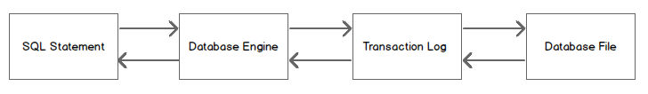
Reliable Storage - Illustrated
A SQL statement is sent to the engine.
Data changes are written to the transaction log
The changes are made to the data file
If they succeed a commit is written to the log, if they fail a rollback occurs
The engine reports status or returns data back to the caller

Slide 13
Rapid Data Access
Databases allow for the creation of indexes, enabling fast data access.
When you query a table with no indexes, your database has to read each and every page of data looking at every row to see if it satisfies your search. This is called a table scan and for large data sets it is bad.

Slide 14
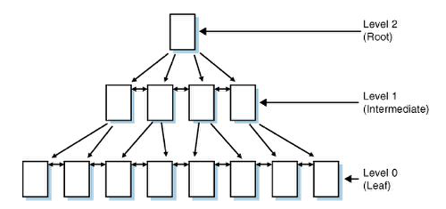
Index Structures
Indexes are stored separately from the actual data pages- they only contain pointers to data pages or rows. Indexes in SQL Server are balanced trees (B-Trees).

Slide 15
B-Trees?
Say we want to index the LastName of a person record.
Think of the levels of the tree as file drawers, each in alphabetical order. Each level points to the next index.
By starting at the top of the tree and working our way down alphabetically, we can avoid searching all of the records, greatly increasing our efficiency.

Slide 16
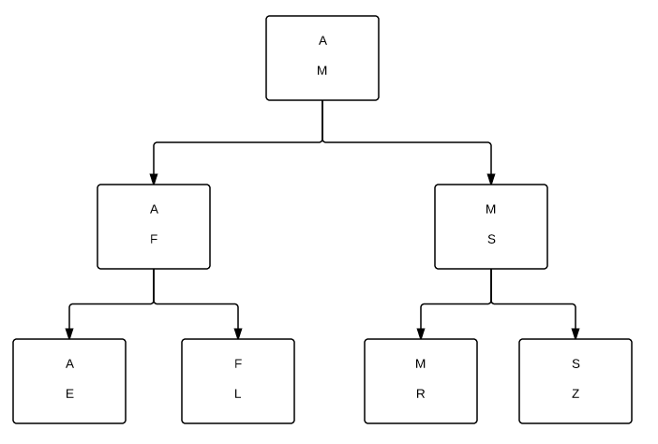
Simplified Index

Slide 17
Consistent Data Access
Getting to data fast means nothing if the data is not accurate. The general idea of consistent data access is to only allow one client at a time to change data and to prevent others from reading data while it is being changed.
This is called “locking”. When two processes try to change the same data concurrently in a way that prevents each from completing, this is called a “deadlock”

Slide 18
Data Integrity
When we set up our table definitions in a database we can provide standards that the database will enforce.
The simplest example is making certain columns of data required, and enforcing types on those columns (int, character, etc)
The relational example is if we have a table with customer data, and another table with addresses for those customers, we can set up rules that prevent a customer from being deleted unless all addresses associated with them are also deleted.

Slide 19
Security
Most major databases allow for the creation of login/password information to access data (or plug into your corporate network’s security to use your network credentials).
Normally a DBA will create Roles which are granted privileges to database objects (read, write, delete) and procedures.
Users are added and removed from roles by the DBAs and it prevents them from having to assign each individual user security privileges. Adding users to roles gives them buckets of priviliges.

Slide 20
SQL Server Runs as a Service
By default, SQL Server starts up when the machine boots and runs as a service (we can see it in the services utility, it actually has several services)
These services run constantly in the background so they are always ready to handle data requests.

Slide 21
Terms You Should Know
Column: A field in a database table. (AKA Field)
Database: A collection of objects to store and retrieve data.
Database Management System: A set of software components and programs that creates, maintains, and controls access to a database.
Data type: An attribute of a field that tells SQL Server what kind of data it may accept. Examples include integers, dates and characters.
Management Studio: The user interface to talk with SQL Server services.
NULL: Unknown or unspecified values.
Query: A question asked to get information from data in a database.
RDBMS: Relational Database Management System is a tool that allows for safe storage of data and quick retrieval of important business information.
Record: A row of data in a table.
Record Set: The set of data returned as an answer to a query. (AKA Result Set)
Service: A process, much like an application, that runs in the background of your system.
SQL: Structured Query Language.
T-SQL: The variant used by Microsoft SQL Server to create databases, populate tables and retrieve data.

Slide 22
Fin
Next up- Basic Queries!

